Slide 1
My Diversity
Power point by Yami Manor junior

Slide 2





Diversity :
Diversity means the presence of differences among people such as gender, ethnicity, religion, disability and more.
It involves recognizing and valuing these differences, creating an environment where everyone feels included and respected.

Slide 3
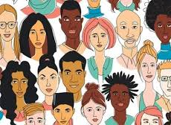
Recognizing Differences:
Acknowledging that people have diverse backgrounds, experiences, and perspectives.

Slide 4
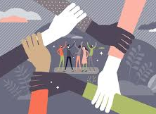
Valuing Differences:
Appreciating the unique contributions that individuals from different backgrounds can bring to a group or organization .

Slide 5
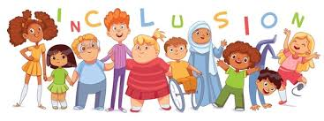
Inclusion:
Creating a welcoming and supportive environment where everyone feels they belong and can participate fully .

Slide 6
Examples of Diversity

Slide 7

Gender:
A team with both men and woman representing different approaches and ideas.

Slide 8
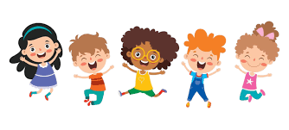
Race & Ethnicity:
A diverse community with people from various ethnic and racial Backgrounds.

Slide 9
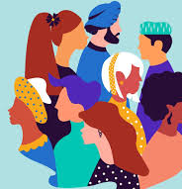
Religion:
Individuals with different religious beliefs coexisting and respecting each other’s faiths

Slide 10
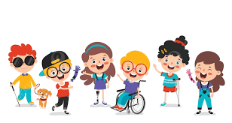
Disability:
A workplace that accommodates employees with physical or mental Disabilities.

Slide 11

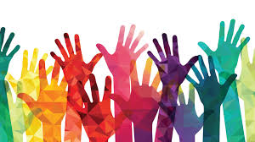

4 types of diversity:
Internal, external, organizational and worldview

Slide 12
Thank you for watching!!!!!!
By Yami
Manor Junior

